Slide 1
Sustainable Municipal Drinking Water Treatment CEE 4540
Introduction
School of Civil and Environmental Engineering
Monroe L. Weber-Shirk

Slide 2
Agenda…
Spanish options!
What is this course about?
Course Organization
Why am I teaching this course?
Introductions
A search for truth that matters
Groupthink: avoiding the truth
Myth in engineering
The Challenge
It is a short walk to the edge of knowledge

Slide 3
Spanish 1501 (section 10222) Friday 10:10-11:00 (subject to change depending on new poll results)
SPAN 1501 is not a language course per se; rather, its aim is to give you strategies to maximize your experience abroad. In this class you will:
develop elementary oral communication skills in Spanish
practice colloquial use of Spanish in realistic situations
acquire dynamic cultural strategies that will enhance study abroad
Meets 1 hour a week
Consists of 1 credit
First class will be held during the second week of classes
Enrolling in this class does not require you to go on the trip and vice-versa. However, this is a great opportunity to develop oral skills in Spanish, especially if you are interested in visiting Honduras with the AguaClara project!
If you need more information, please email me at ecv27@cornell.edu

Slide 4
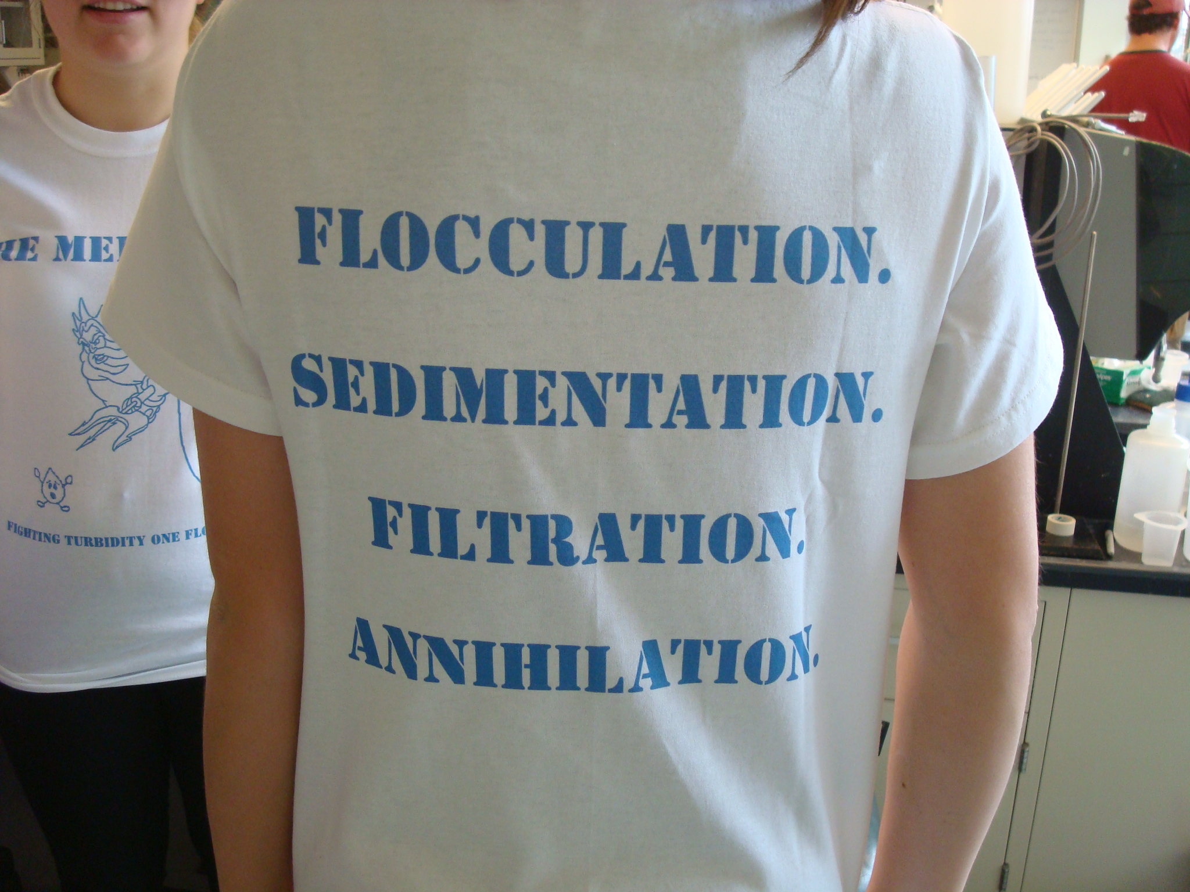
What is this course about?
Creative thinking about solutions to the enormous challenge of providing safe water on tap to communities everywhere.
We will challenge the myth that this task can be accomplished by applying traditional technologies and we will identify opportunities for new insights
We will be introduced to the new field of sustainable drinking water treatment
My thesis is that engineers are needed to challenge existing assumptions and to create and document new sustainable solutions

Slide 5
What is this course about?
I have the goal of helping you develop a fundamental understanding of the processes that control the performance of each of the drinking water treatment steps,
for a VERY specific problem; the production of safe drinking water for communities starting from surface waters that are contaminated with sediment and microbes.

Slide 6
Course prerequisites
CEE 3310 or equivalent Fluid Mechanics course
CEE 3310 can be taken at the same time if you are willing to work harder in CEE 4540 and use your fluids text as a reference
Online Fluids alternative https://confluence.cornell.edu/display/cee4540/Fluids+Review+Guide

Slide 7
Curriculum Model: AguaClara RIDE
Expert
Guide
Novice
Research and Invent
Knowledge Generation
Theory: Capstone Design Course
Knowledge Synthesis
Graduate Research
3 Project Based Courses
First year to M.Eng.
Every semester
Summer Internships at Cornell
Engineering in an international context
International Experience Course
Notes:
Knowledge generation (project) courses
Students learn from students with more expertise
Students generate new knowledge!
Knowledge flow is in multiple directions
Students can take the project courses multiple times from first year to Master of Engineering
Knowledge synthesis courses
Material includes recently generated knowledge
Amanda Crawford-Staub
Student Relations and Strategic Partnerships Associate
Study abroad, short term programs into curriculum, talk with many universities
By and large u’s are trying to integrate short term programs.
One course, one trip model is actually relatively new.
Old model was lecture on the trip.
Haven’t seen anything as extensive and well developed at other universities.
Model with multiple courses is unique.
70% of our students come from STEM.
Students are looking for something more than the short trip experience.

Slide 8
Course Organization
CEE 4540 wiki : home to everything
https://confluence.cornell.edu/display/cee4540
Class time logistics
Video recording synched with lecture notes
Design Challenges (teams) – except for tutorial!
?? Quizzes, 2 Exams (computer based using Python) 1 Final Project
Software skills for designing sustainable infrastructure
We will provide opportunities for you to become an expert in design using open source software
Notes:
Explain design challenges and due dates
Initial survey
Power point
Encouage students to work with PDF and take notes on top of my notes in class.

Slide 9
Design Challenges
How do you learn?
Why teams?
Drafts and final submission
Python tutorial
Download Anaconda today! (see https://confluence.cornell.edu/display/cee4540/Anaconda)
This Friday’s class dedicated to making sure you can start on the Python tutorial (BRING YOUR LAPTOP)
Notes:
Play!
Sense of timelessness (time doesn’t matter)
Y

Slide 10
First Assignment
Learn how to use Jupyter Notebooks for engineering in the next 2 weeks
Hardest assignment of the semester
Start TODAY by downloading and installing software

Slide 11
Introductions: Name that Student
Think about efficiency (multitasking)
Write your first name on the blackboard while you are waiting
Point to your name on the board
Describe VERY briefly something you did this summer that involved water using third person (Monroe built a dam this summer)
Ask the class, “What is my name?”

Slide 12
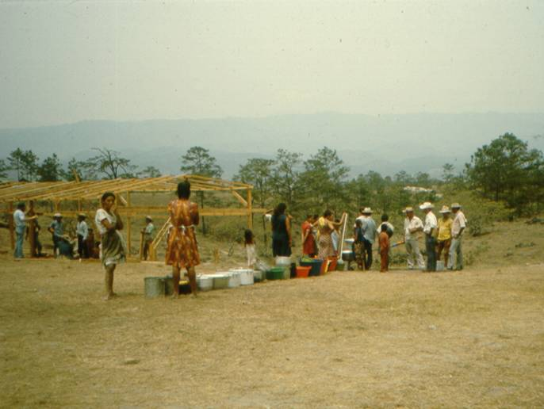
Why am I teaching this course?
Experience in refugee camps in Honduras in 1982-83
The spark of interest: What makes slow sand filters work?
The discovery that no one knew
Invitation to begin a water project in Latin America (12/2002)
The realization that what I had been taught wasn’t up to the challenge of solving the big global challenge of providing safe drinking water on tap to communities
13th time teaching this course – changes every time!
Notes:
Realization that we were assuming that knowing how to build water treatment facilities in the US prepared students for tackling the problem anywhere on the planet.
Issues of scale and resources (human, capital)

Slide 13
Mesa Grande: Waiting for water

Slide 14
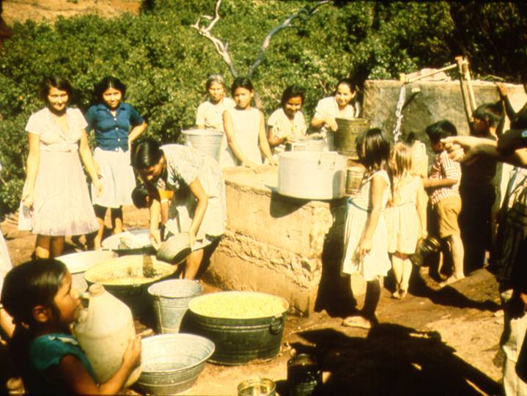
Water in Colomoncagua

Slide 15
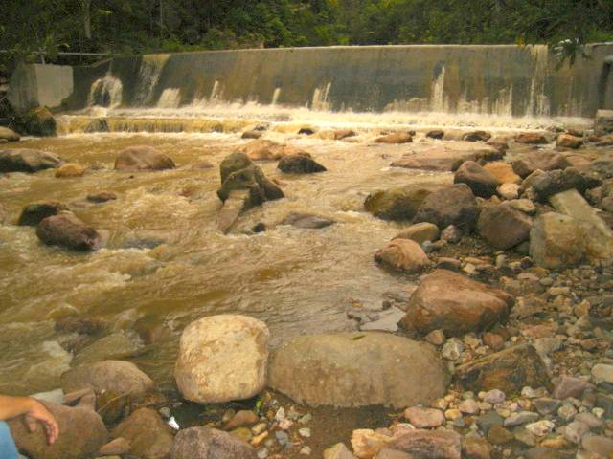

Slide 16
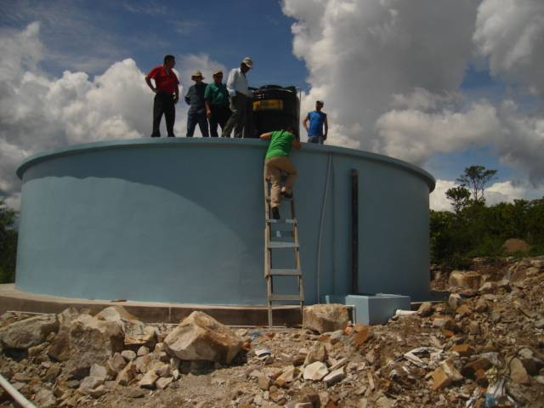

Slide 17
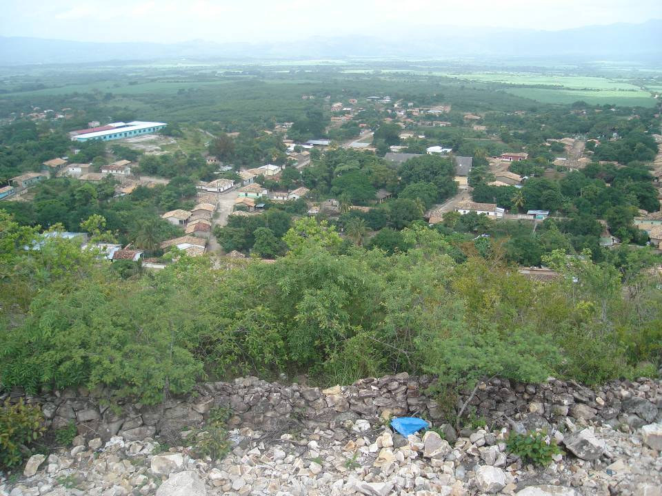

Slide 18
You should be taking a course in business or information technology
Environmental Engineering is a dead profession
The science behind environmental engineering is already well understood
Environmental engineers have been applying the same solutions for the past 100 years
Providing everyone on the planet with safe drinking water only requires the money and political will to apply known technologies
Discussion time! Do you agree?
Notes:
Dead: no! We need to be playing a major role in improving public health and in protecting the environment from human waste and
Already understood: Many things are well understood. Others need much more research (coming up)
Same solutions: Many of our solutions are 80 years old. But our 80 year old solutions haven’t provided everyone with decent water and sanitation. So we need new solutions that can be implemented where the constraints are more severe.
Known technologies: Same as previous argument. The known technologies may not be the best solution to the new types of problems we are trying to solve. And every situation requires a new assessment of which technologies are best.

Slide 19
Uneven Knowledge Space
nanotechnology
Water purification
WMD
pharmaceuticals
Learn from adjacent knowledge spaces!
Notes:
Much to learn
The potential for improving the well being of humans and of the planet is enormous
The challenge: to make the same progress in water supply as we are making in the hot sciences.
Nano technology is really cool. Nanotechnology isn’t going to provide the world with safe drinking water, food, or transportation networks. Some engineers should definitely explore nanotechnologies. More engineers should develop efficient and sustainable infrastructure for a healthy society.
This is science that is directly connected to the messiness of the real world. The problems can’t be solved exclusively in the lab (although there are many technical challenges that need laboratory investigations).

Slide 20
Causes of Uneven Knowledge Expansion
extra
Funding agency (top down science)
Target a few areas for growth
Soccer game syndrome
National Pride/Security Agenda
Dams
WMD
NASA
Private Enterprise
The historic preference for high tech inefficiency rather than robust, sustainable technology
Private enterprise historically created solutions that require proprietary components

Slide 21
The Challenges of Creating New Knowledge
extra
In many areas of engineering you only have to investigate a little to find the knowledge boundary
Flocculation
Porous Media Filtration optimization
Flow control for chlorinators
Efficacy of various coagulants
New knowledge (especially when at odds with tradition) takes years and even decades to be adopted when economies of competitive mass production aren’t at work

Slide 22
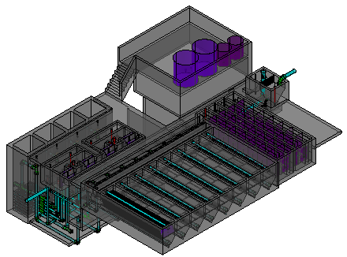
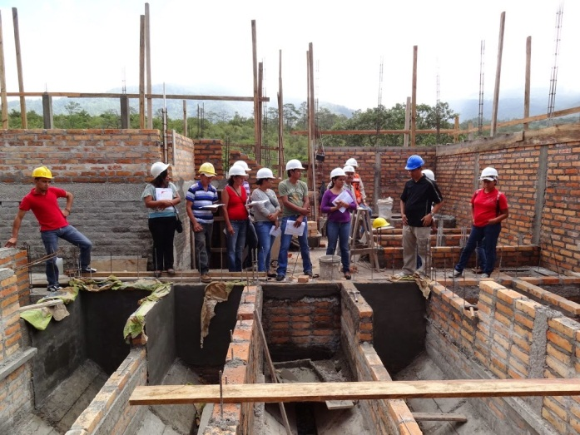
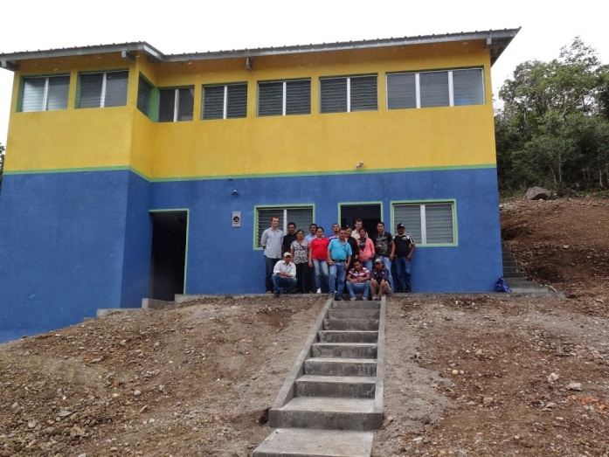
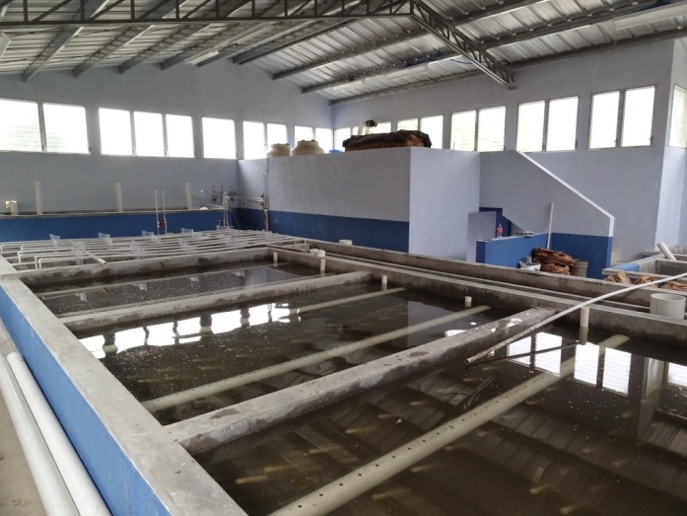
A Search for Truth that Matters
AguaClara is creating new technologies, improving old technologies, and developing the design algorithms so that others can build surface water treatment plants of any size
Math – Physics – Fluid Mechanics – Chemistry
The amazing ability to represent reality symbolically

Slide 23
Learning in a collaborative environment (Team assignments)
Our big goal is that we all learn as much as possible
How do you learn?
 | Asking for help to learn a solution | Retyping a solution | Copy/paste some solution steps | Copy/paste design challenge
Individuals within team | Excellent | Okay (but better to learn the solution strategy) | Okay (with the goal of all members understanding the steps) | Not applicable
Collaboration between teams | Excellent | No | No | No

Slide 24
Groupthink
Groupthink refers to faulty decision-making in a group (coined by Irving Janis, 1972)
Groups experiencing groupthink do not consider all alternatives and they desire unanimity at the expense of quality decisions
Irving, Janis. (1972). Victims of groupthink. Boston: Houghton Mifflin; Irving, Janis. (1982). Groupthink: Psychological studies of policy decisions and fiascos. 2nd ed. Boston: Houghton Mifflin.

Slide 25
Results of Groupthink
extra
Examining few alternatives
Not being critical of each other's ideas
Not examining early alternatives
Not seeking expert opinion
Being highly selective in gathering information
Not having contingency plans
True, true, true!
Why would a group adopt these behaviors?
Notes:
http://www.abacon.com/commstudies/groups/groupthink.html
How do you know that? What is the evidence?
Self confidence
Afraid of conflict
Expert might humiliate you.
Contingency plans and examining alternatives takes work
It feels good to have everyone agreeing with you!

Slide 26
Some Symptoms of Groupthink
extra
Having an illusion of invulnerability
Rationalizing poor decisions
Believing in the group's morality
Sharing stereotypes which guide the decision
Exercising direct pressure on others
Not expressing your true feelings
Maintaining an illusion of unanimity
Using mindguards to protect the group from negative information
These are the people who filter the information coming to the group. They make sure that outside information is suppressed or reinterpreted if it fails to support the cherished assumptions of the group. As a result of this process, the group makes its decision only upon information that is supportive of that decision. This builds up a self-fulfilling cycle of correctness. The illusion of rightness and unanimity is preserved; no disruptive questioning or information is admitted by the group.
peer review
Notes:
http://www.abacon.com/commstudies/groups/groupthink.html
These are the people who filter the information coming to the group. They make sure that outside information is suppressed or reinterpreted if it fails to support the cherished assumptions of the group. As a result of this process, the group makes its decision only upon information that is supportive of that decision. This builds up a self-fulfilling cycle of correctness. The illusion of rightness and unanimity is preserved; no disruptive questioning or information is admitted by the group.

Slide 27
Some Solutions to Groupthink
Admit that you don’t know everything!
Encourage honesty!
Question everything
Check with outside experts
Hold a "second-chance meeting" to offer one last opportunity to choose another course of action
Notes:
http://www.abacon.com/commstudies/groups/groupthink.html
Create a climate where disagreement is welcomed

Slide 28
Welcoming Dissent
extra
Hi guys, August, 2008 It occurred to me that before we build the 1.2 m deep AguaClara plant we should all stop for a few minutes and check to see if there is anything that bothers us about this bold new step. Remember the first lectures of CEE 454 when I talked about group think? Group think is when we all work to avoid encountering uncomfortable truths. We keep the party line going and suppress new information that could have caused us to reconsider our plans. Group think is sometimes cited as the cause of the Challenger tragedy. So now is the time to make sure we welcome dissenting views. If any of you have seen anything or have any gut feelings about sedimentation tanks or flocculators that makes you think that our design for 1.2 m deep tanks is risky or prone to failure, we want to hear it! You can see a draft CAD design at https://confluence.cornell.edu/display/AGUACLARA/Cuatro+Comunidades. (you will need the free viewing software).

Slide 29
How might Environmental Engineers fall into the trap of groupthink?
I don’t want to discover that my technology is obsolete and that the years of effort that I put into improving that technology have been a waste
Confusion of confidence and scientific proof
Reliance on empiricism rather than physics
Confusion of the ability to name a process (Flocculation) with an understanding of the physics of the process
Reduce “groupthink” by… _______________
Respect AND question!
Notes:
Dissenters are stupid
We are too often operating under the assumption that the person in the front of the room knows everything and the student role is to soak up the knowledge.
As the problems become more complex with multiple objectives the need to explore alternatives becomes very important.
How is water cleaned in an AguaClara plant?
Disagreements are encouraged!
Always look for the evidence and assess the evidence yourself. Beware of poorly substantiated conclusions.

Slide 30
Role of Myth in Environmental Engineering
extra
Myth can be a useful way of understanding a complex reality
creation stories
Myth can also be used to describe generally accepted but unproven hypotheses (my usage here)
Myth #1: Science and engineering aren’t influenced by myth because they are based on the scientific method

Slide 31

Historic Examples of Myth
extra
Malaria (bad air disease hypothesis)
Streams purify themselves in 1 mile
The air coming out of the ground under conditions of low or sinking groundwater causes typhoid
Notes:
http://www.sciencedirect.com/science?_ob=MImg&_imagekey=B6V73-45FSRSX-1-K&_cdi=5831&_orig=browse&_coverDate=09/30/2002&_sk=999639984&view=c&wchp=dGLbVtb-zSkzS&_acct=C000022719&_version=1&_userid=492137&md5=fffe3104bff87c2e91320230a4a97810&ie=f.pdf

Slide 32
Environmental Engineering/Public Health Myths (or suspects!)
extra
Dead bodies cause disease
Slow sand filters ripen because of biological growth in the filter bed
Chlorine disinfects dirty water
Chlorine eliminated typhoid fever from the US
Cessation of chlorination due to fear of Disinfection By Products caused the cholera outbreak in Peru in 1993
We already know how to solve the problem of the 3 billion people who do not having access to safe drinking water

Slide 33
The Creation of Myths in Peer Review Literature
extra
Publish an article where you list hypotheses that might explain some scientific phenomenon
Quote that first article and fail to mention that it was an unproven hypothesis
Eventually literature reviews at the beginning of scientific papers in your field will refer to this hypothesis as if it were a theory
Voila!

Slide 34
Uncovering a “Theory” to Reveal a Myth or a Knowledge Gap
extra
Does this “theory” provide insights that have led to new discoveries or new applications?
Does the “theory” include equations that are based on the fundamental laws of nature?
Does the “theory” use dimensionless constants that are close to one?
Is it an elegant “theory” with no need for special cases?

Slide 35
Expose the Myth
Let’s expose some more environmental engineering myths
Don’t believe everything I say
You should always be asking,
How do we know that?
Why can’t we do this better?
There are many things that I have taught in this class in previous years that I now know are wrong or incomplete understandings

Slide 36
The Challenge: Sustainable Municipal Drinking Water Supplies
We need the brightest and the best to create new and better solutions so we can meet the goal of providing everyone with safe drinking water
This challenge is apparently more difficult than building a space station, designing a fuel cell, or inventing the world wide web
So let’s role up our sleeves and begin…
Notes:
Sustainable Small-Scale Water Supplies

Slide 37
Opportunities
Honduras trip in January
Fluoride removal reactor pilot Summer 2018
Recruit leaders
Recruit for Honduras interns
AguaClara Engineers
Fulbright Scholar!

Slide 38
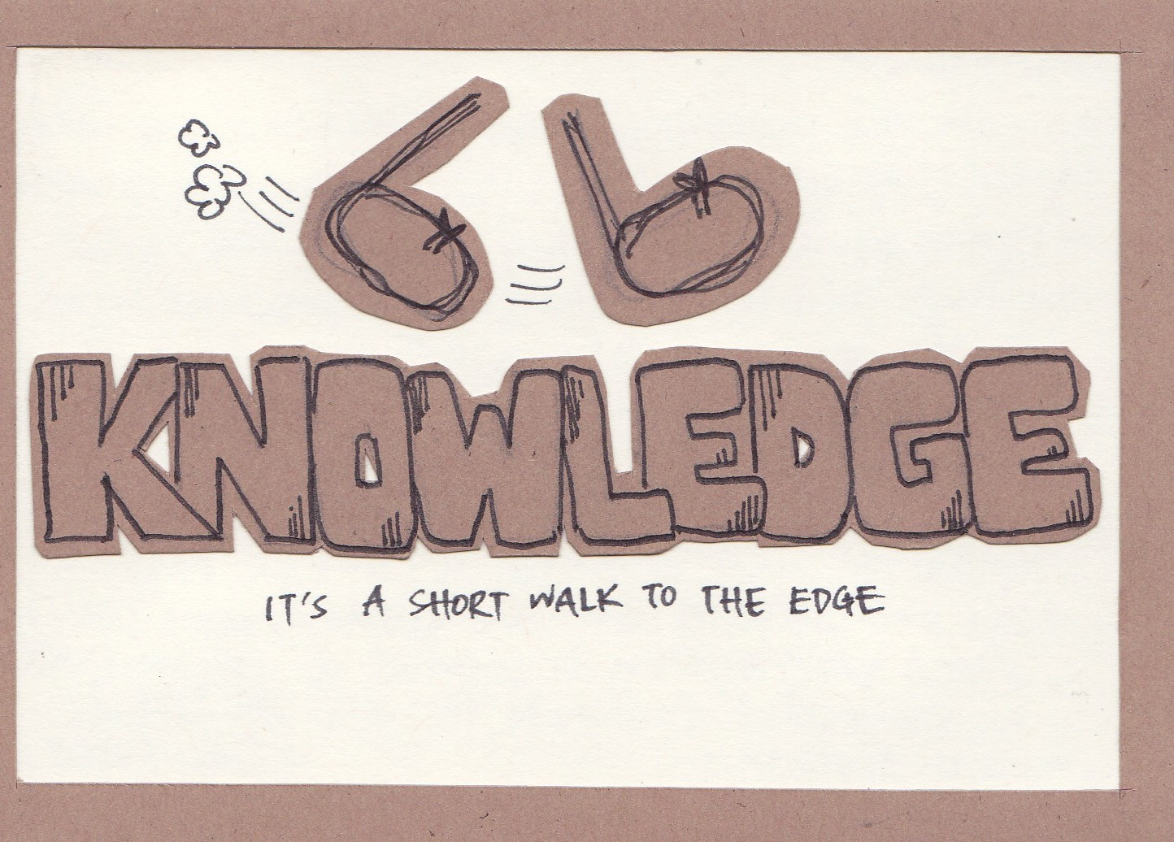

Slide 39

It is a short walk…
…to the edge of knowledge
There are significant knowledge gaps in every process that I will be teaching in this course
We aren’t able to optimize surface water treatment processes because we don’t yet understand the fundamental physics of many of the processes
We are getting closer…

